Slide 1
Updated Status of S-100 PCB
S-101PT4 Presented by KHOA
S-101 Electronic Navigational Chart Project Team

Slide 2
Introduction
S-100 Portrayal Catalogue Builder (PCB)
Reported the progress at the S-100WG4 meeting in Denmark 2019
Develop and test S-100 PCB since S-100WG4 meeting
Updated status of S-100 PCB
Project 'Development of an S-101 Portrayal Catalogue' conducted by IIC and CARIS
Reviewed the KHOA S-100 PCB when they drafted the S-101 PC
This paper describes key elements of the S-100 PCB 1.0.0 and reports the progress on improving the PCB and its release plan

Slide 3
Feedbacks
Major issues
Add a sand box function that new items like Symbol, Display priority and Display plane, etc. could be proposed (Local XML DB will be located in the S-100 PCB to support the sand box function)
Preview function of Symbol
Interface to define Styles and Templates
Interface to define Context Parameters, Mariner Settings, Conditional Procedures and Functions
Function to export to Lua for S-101 (Planned)

Slide 4
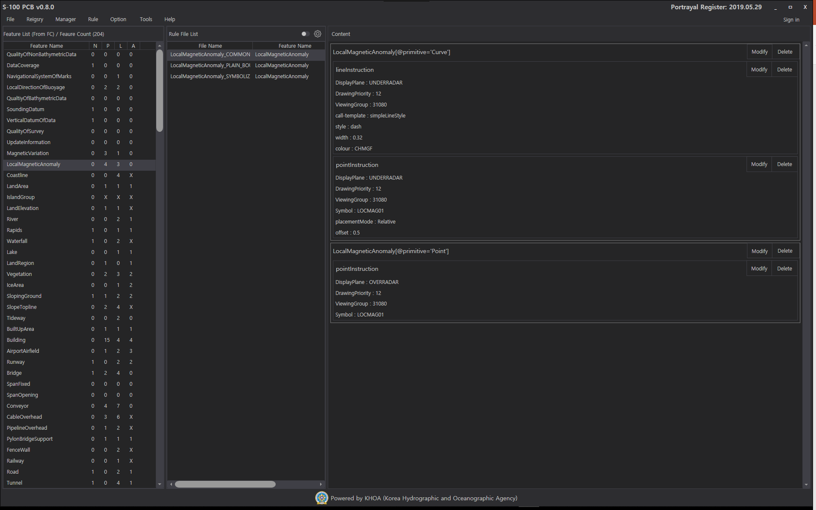
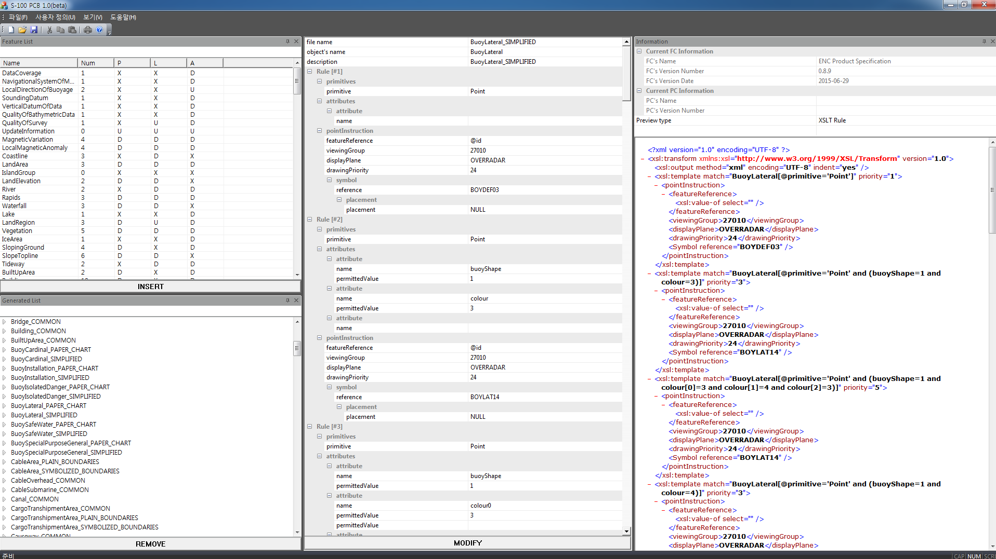
Updated information
The NEW UI for S-100 PCB

Slide 5
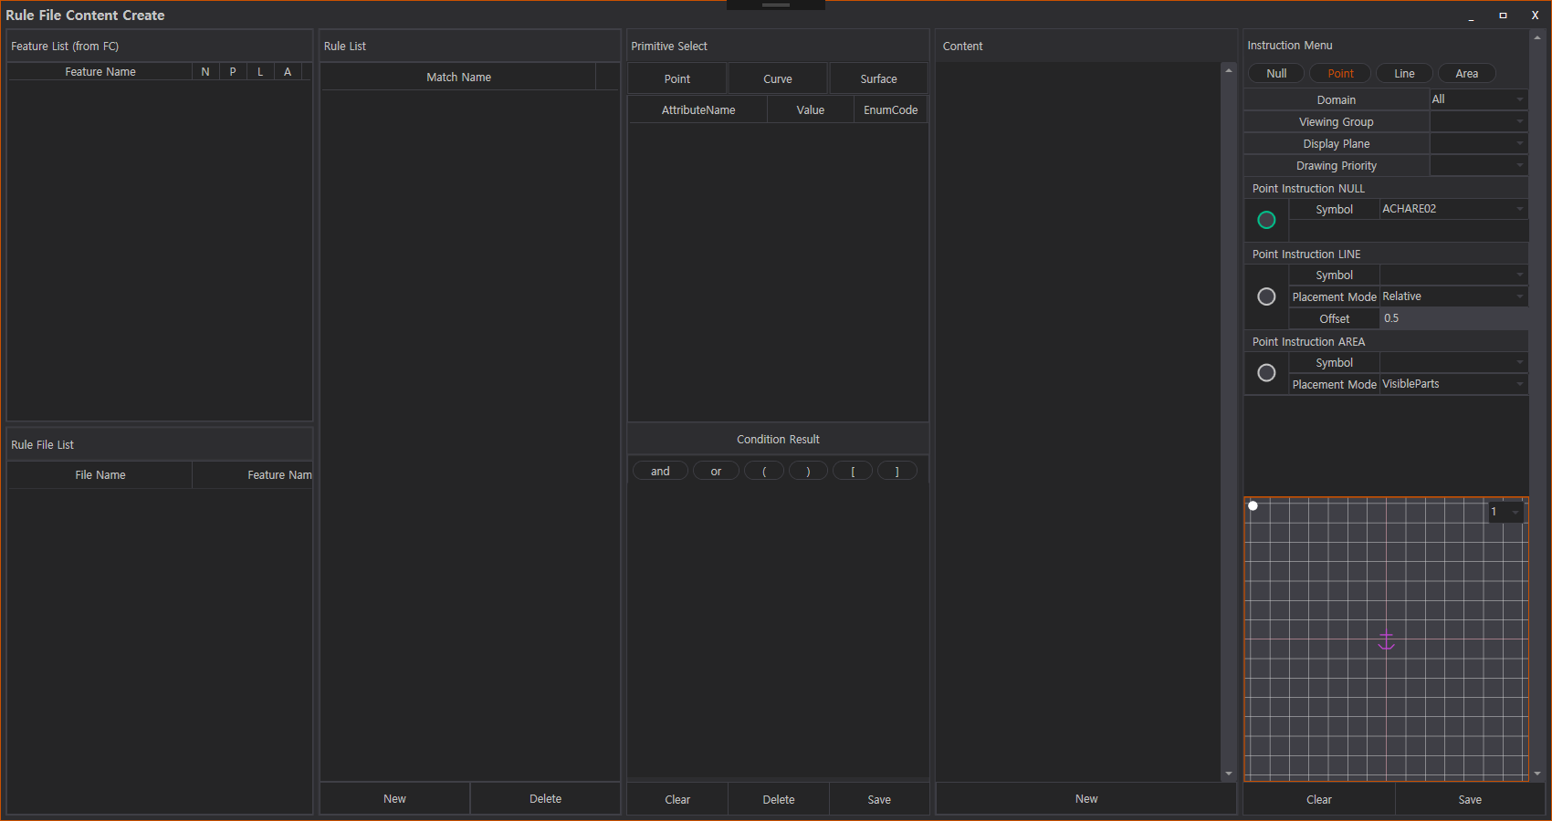
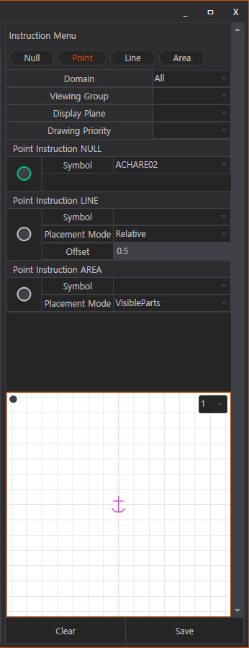
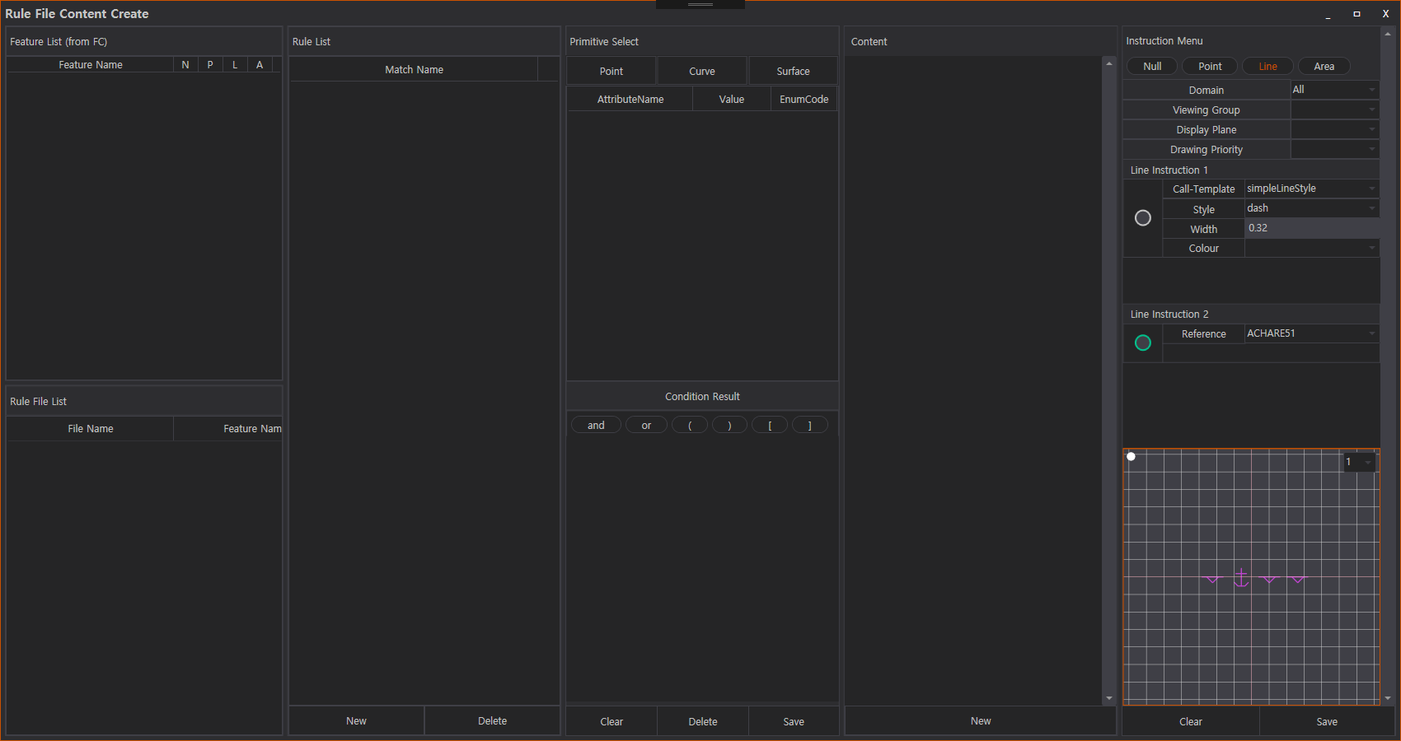
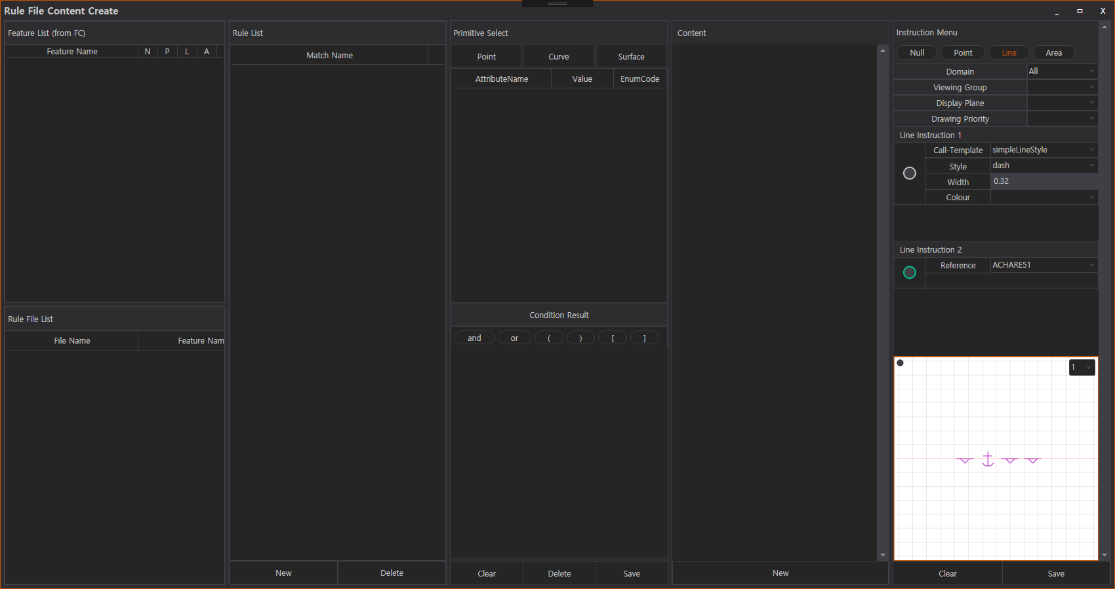
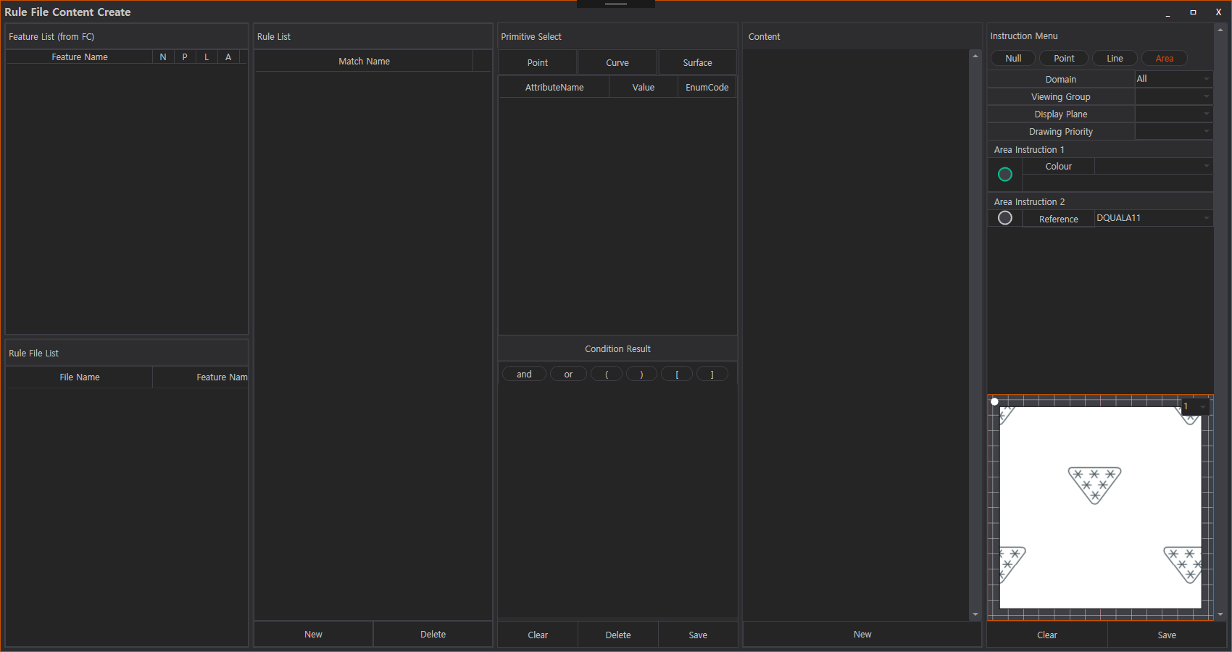
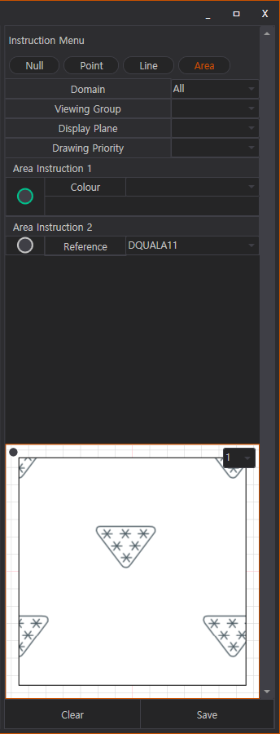
Updated information
The S-100 PCB supports:
Preview function for Symbol, Linestyle, Areafill types

Slide 6
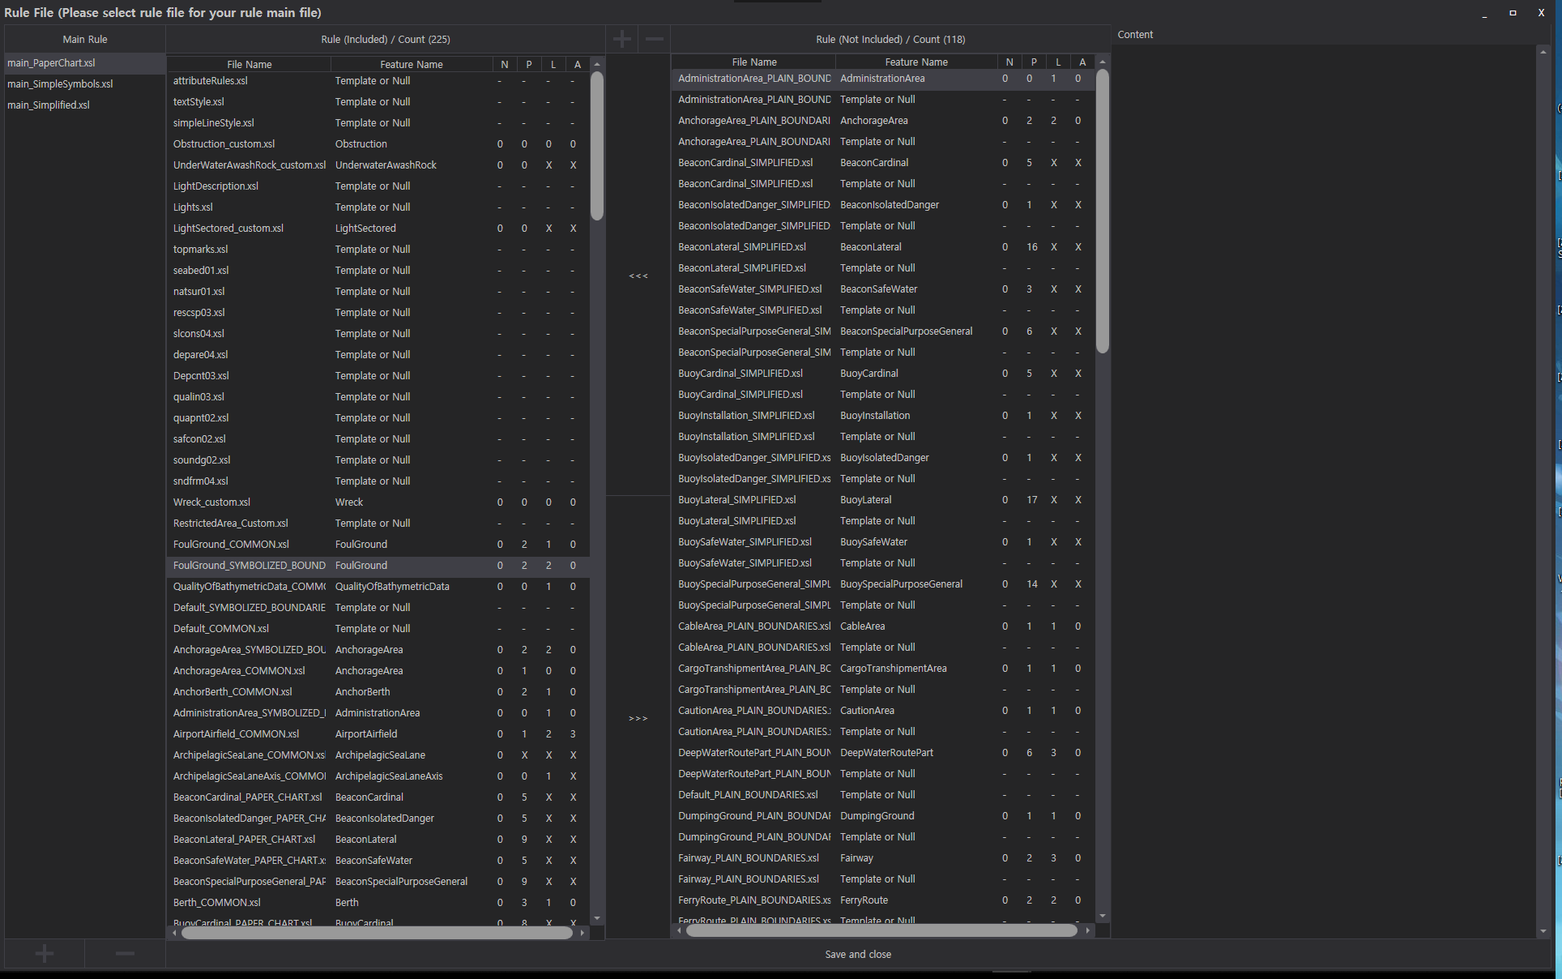
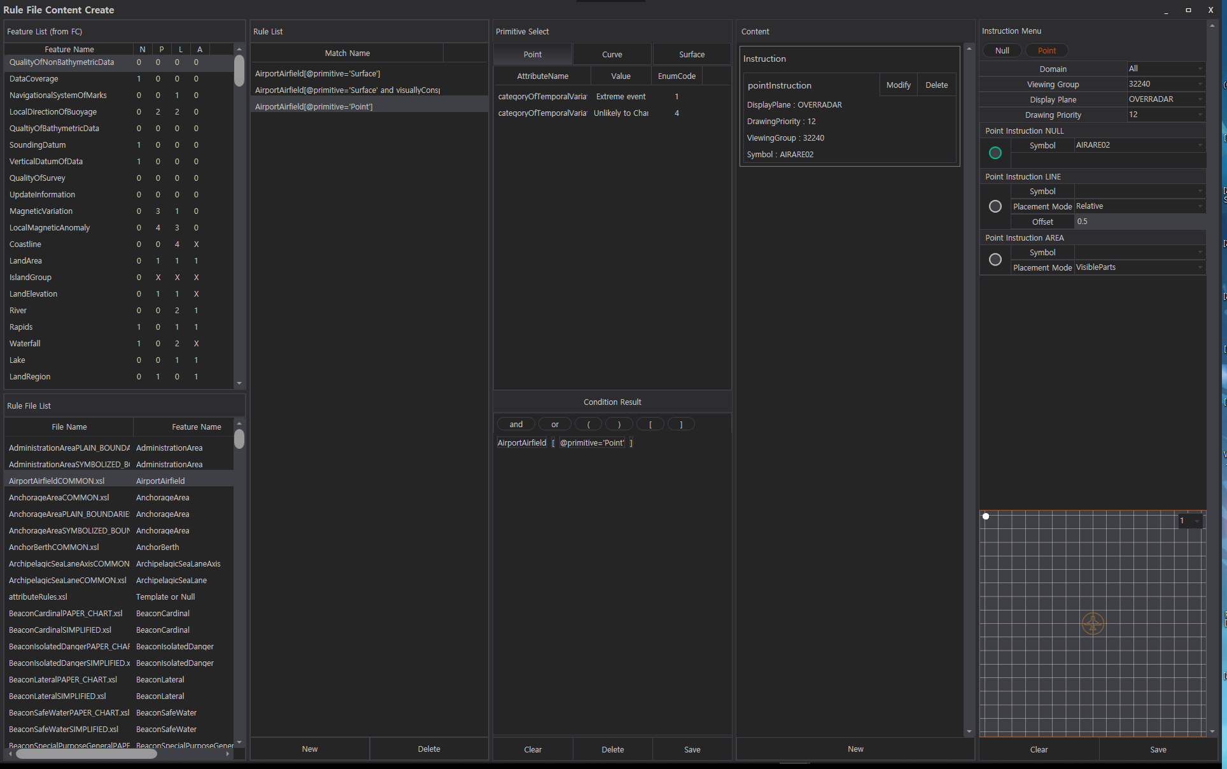
Updated information
The S-100 PCB supports:
New interface to create and manage the main rule files
New interface to define rules

Slide 7
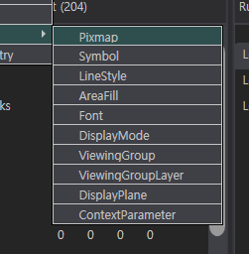
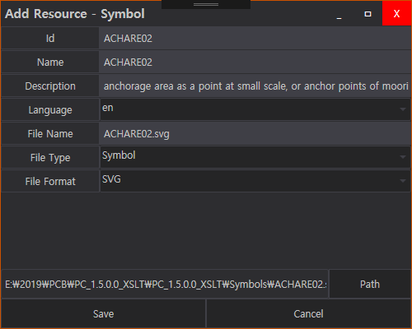
Updated information
The S-100 PCB supports:
To add user defined resources to create a draft PC before registering to the Registry

Slide 8
Conclusion
The next plan of KHOA with S-100 PCB is:
Final Draft version of S-100 PCB will be open soon
Remaining items such as exporting S-101 Lua will be developed by S-100WG5
The S-101PT4 is invited to:
a. Note this paper

